Slide 1
Java Basic
Java variables and literals
Java Datatypes and Operator
Input & Output
Java expression, block and Comment
Keyword in Java
Java if…else
Switch statement
Loop
Array

Slide 2
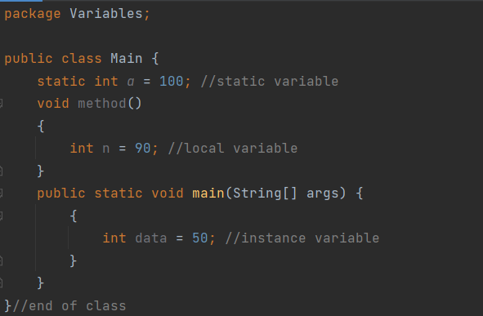
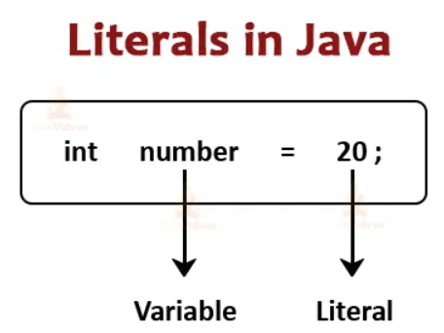
1. Java variables and literals
*Java variables:
A variable is a container which holds the value while the Java program is executed. A variable is assigned with a data type.
There are three types of variables in java: local, instance and static.
*Literals:
Literals are the data items that have fixed or constant values
Java allows 6 kinds of literals which are:
- Boolean Literals: gồm 2 giá trị true and false
- Integer: Binary, Decimal, Octal, Hexadecimal
int binary = 0b10010;
int Octal = 027;
int Decimal = 34;
int heximal = 02xF;
- Floating – point Literals
- Character Literals: char letter = ‘a’;
- String Literals: String str1 = “Phan Hai”
- Null Literals: Null literals are the values that represent null values (null)

Slide 3
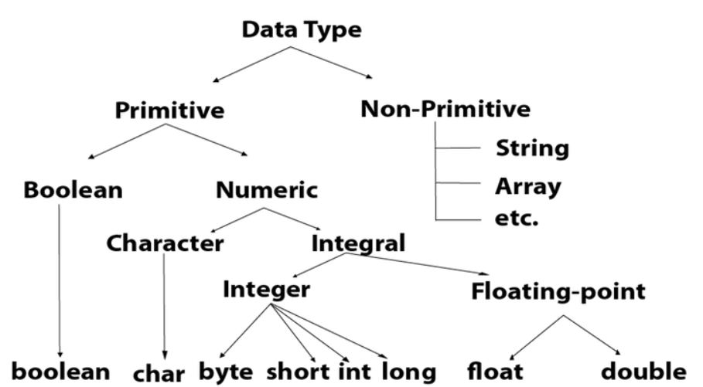
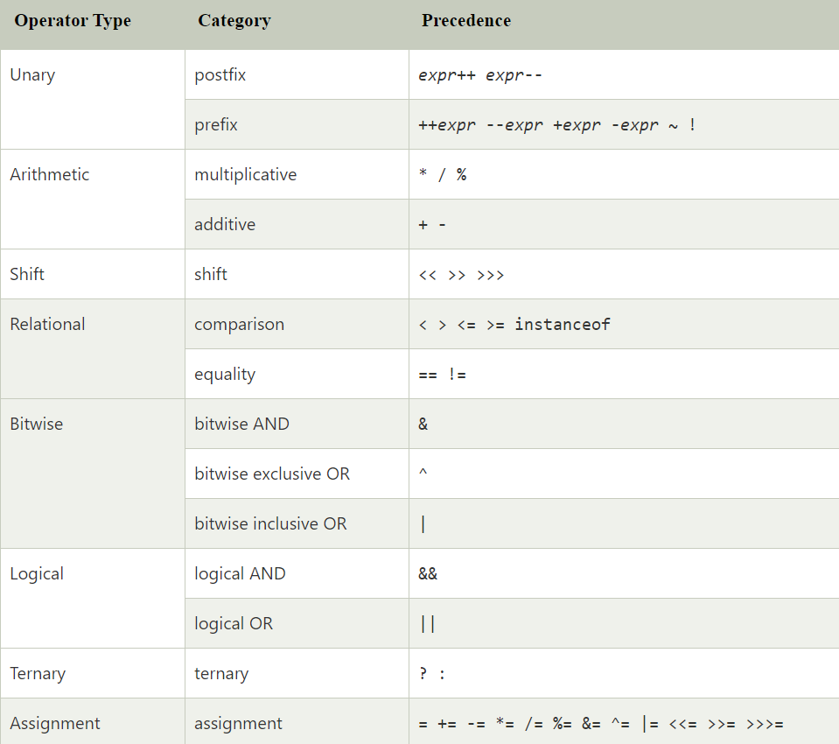
2. Java Datatypes and Operator
*Datatypes: Data types specify the different sizes and values that can be stored in the variable
*Operator: a symbol that is used to perform operations

Slide 4

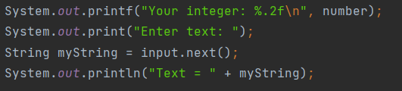
3. Input & Output
*Input: Java provides different ways to get input from the user
Import java.util, java.io
Example:
*Output: can simply use
system.out.print(): It prints string inside the quotes.
system.out.println(): similar like print() method. Then the cursor moves to the beginning of the next line.
system.out.printf(): It provides string format
Example:

Slide 5
4. Java expression, block and Comment
Java expression: A Java expression consists of:
Variables.
Operators
Literals
method calls
Java block: A block is a group of statements (zero or more) that is enclosed in curly braces { }
Comment:
- Single Line Comment: //
- Multi Line Comment: /* */
- Documentation Comment: /** */

Slide 6
5. Keyword in java
abstract: Java abstract keyword is used to declare an abstract class. An abstract class can provide the implementation of the interface. It can have abstract and non-abstract methods.
boolean: Java boolean keyword is used to declare a variable as a boolean type. It can hold True and False values only.
break: Java break keyword is used to break the loop or switch statement. It breaks the current flow of the program at specified conditions.
byte: Java byte keyword is used to declare a variable that can hold 8-bit data values.
case: Java case keyword is used with the switch statements to mark blocks of text.
catch: Java catch keyword is used to catch the exceptions generated by try statements. It must be used after the try block only.
char: Java char keyword is used to declare a variable that can hold unsigned 16-bit Unicode characters
class: Java class keyword is used to declare a class.

Slide 7
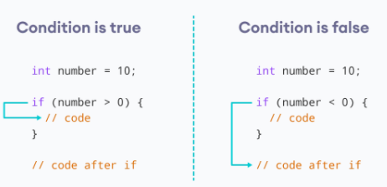
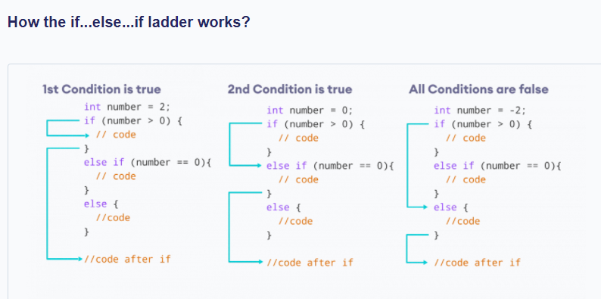
6. Java if…else
if..then statement:
If…else statement:
if-else if ladder Statement: The if-else-if ladder statement executes one condition from multiple statements.
Nested if statement: the if block within another if block. Here, the inner if block condition executes only when outer if block condition is true.

Slide 8
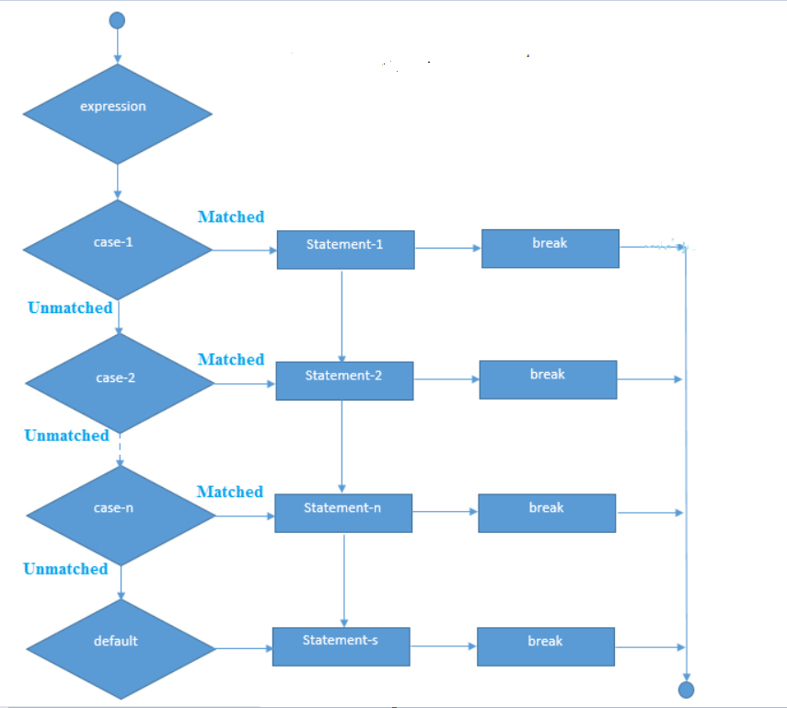
7. Switch Statement
- The Java switch statement executes one statement from multiple conditions

Slide 9
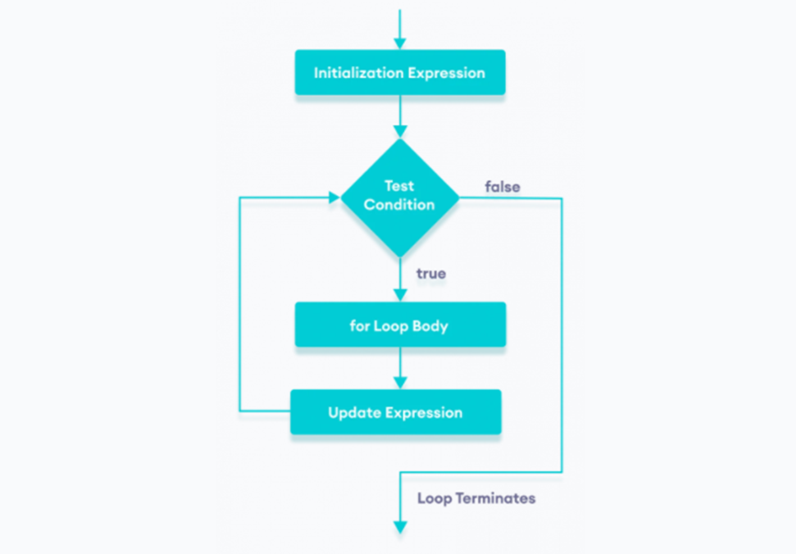
8. Loops in Java
*Java For loop: The Java for loop is used to iterate a part of the program several times. If the number of iteration is fixed, it is recommended to use for loop.

Slide 10
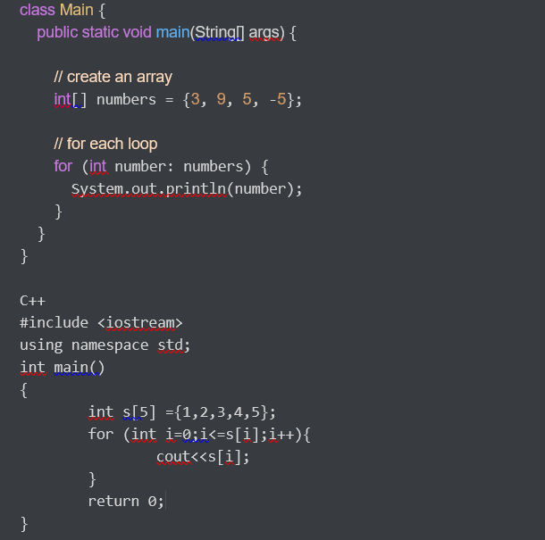
For – each loop: used to traverse array or collection in java
Example:

Slide 11
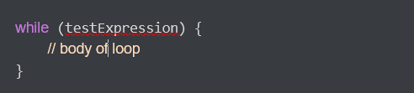
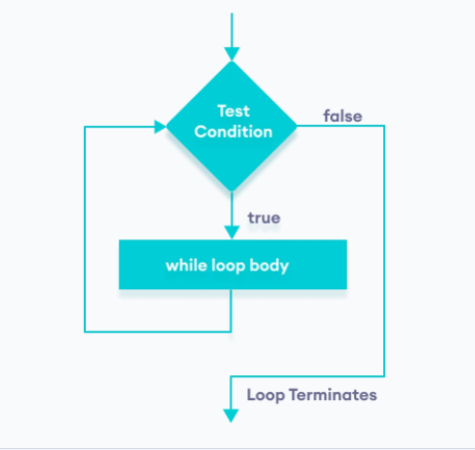
*Java While loop:
Syntax:

Slide 12
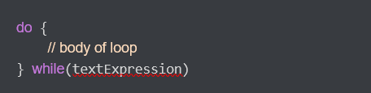
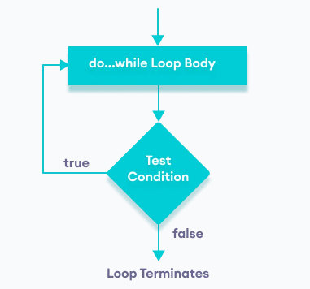
*Java Do - While loop
Syntax:

Slide 13
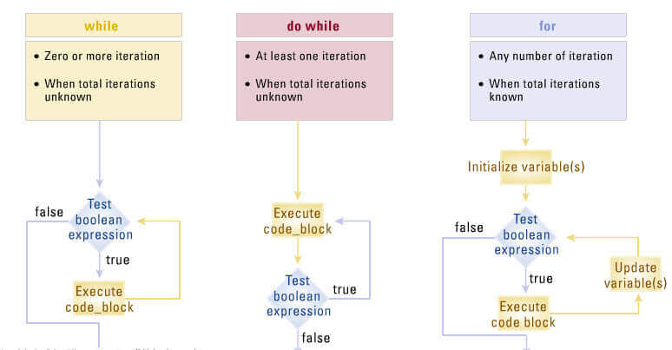
Loop in Java

Slide 14
Loop in Java
- Java loop for: it used to repeat a part of the program many times. The loop for is often used in cases where the number of iterations is fixed
- Java For –Each Loop: A loop is used to traverse an array or a collection, its moves from the first word to the last element of the array or set in turn.
- Java While Loop: Its used to execute a program repeatedly, while a condition is still true. While loop is usually used when the number of iterations is not predetermined
- Java do – While Loop: Its used to execute a program segment multiple times. The characteristic of do – while is that a block of code is always executed at least once.

Slide 15
9. Array:
Java array is an object which contains elements of a similar data type
Advantages:
- Code Optimization: It makes the code optimized, we can retrieve or sort the data efficiently.
- Random access: We can get any data located at an index position.
Disadvantages:
- Size Limit: We can store only the fixed size of elements in the array. It doesn't grow its size at runtime. To solve this problem, collection framework is used in Java which grows automatically.

Slide 16
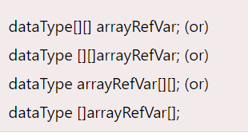
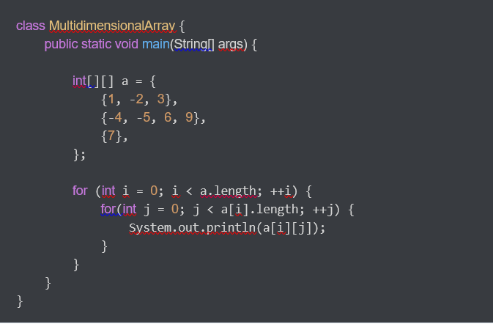
Multidimensional Array in Java
Syntax:
Example:

Slide 17
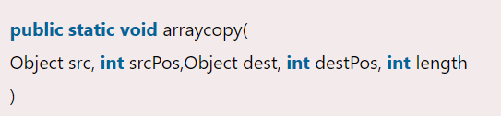
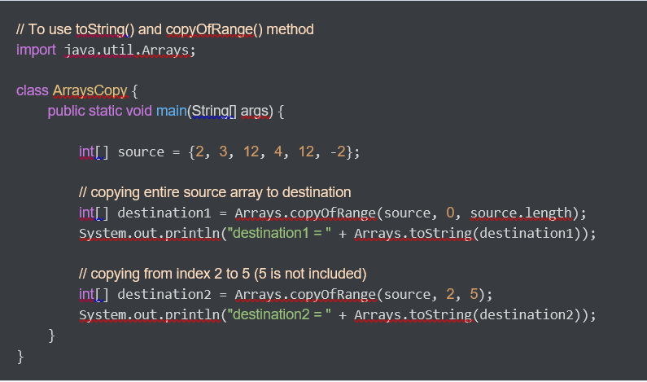
Coppy Array:
Syntax:
Example:

